Slide 1
How do annual members and casual riders use Cyclistic bikes differently
Kyi Zar Kyaw

Slide 2
INTRODUCTIONrIntroductionvoductiontroduction
Business Task : How do annual members and casual riders use Cyclistic bikes differently

Slide 3
OVERVIEWrIntroductionvoductiontroduction
Total number of rides by member and casual
Average ride length by member and casual
Most frequently ride stations
Bike Types preferred by member and casual
Monthly Trends
Seasonal Trends
Which days bikes are mostly used

Slide 4
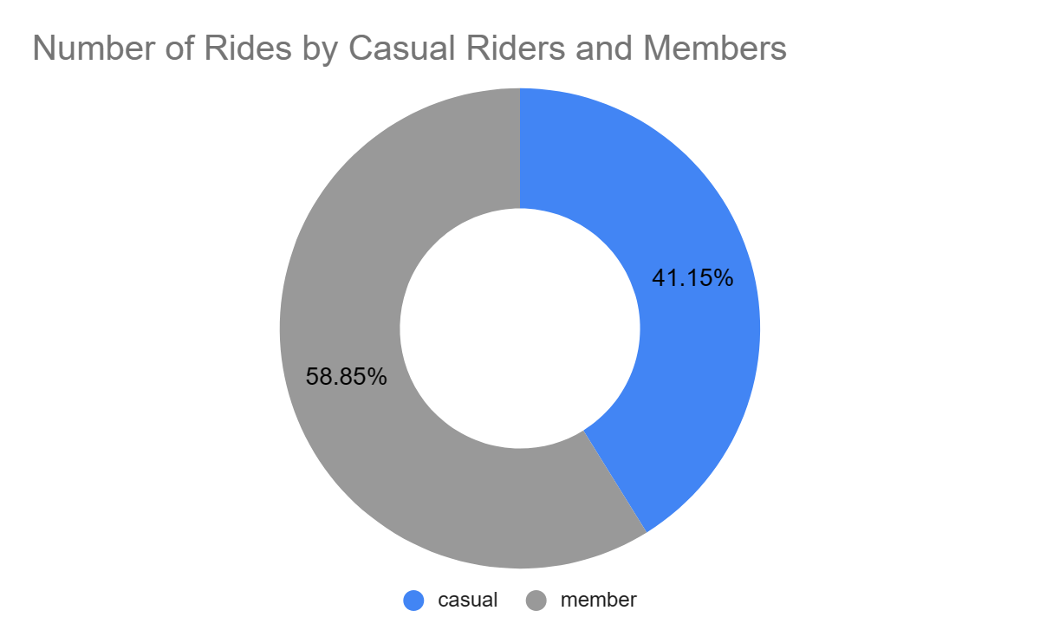
Total Number Of Rides
Total rides of 5,442,716
Members took more rides than casual riders with 58.85% of toal rides.

Slide 5
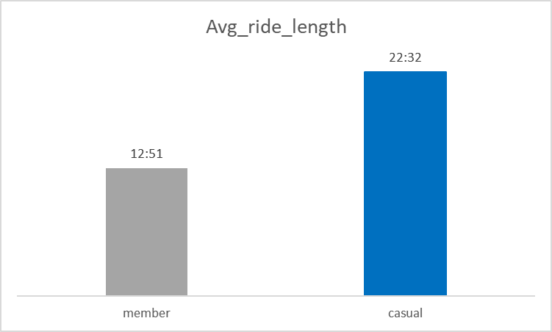
Length of Rides
Casual riders took longer rides than members
Average ride length of casual rider is 22 minutes and 32 seconds
Average ride length of members is 12 minutes and 51 seconds

Slide 6
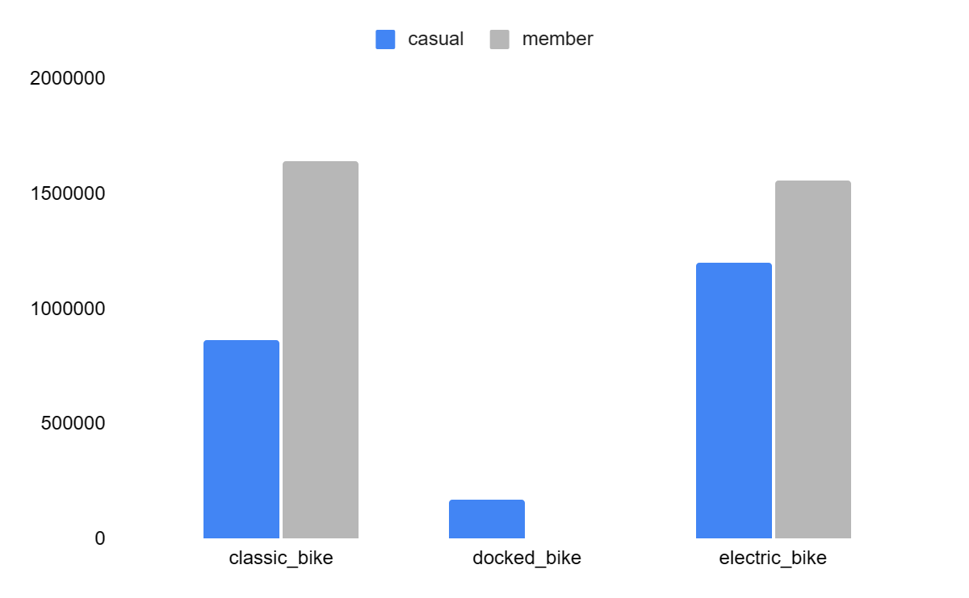
Other findings
Most rides by casual riders are at Streeter Dr & Grand Ave and DuSable Lake Shore Dr & Monroe St.
Casual riders mostly prefer electric bikes and members prefer more on classic bikes

Slide 7
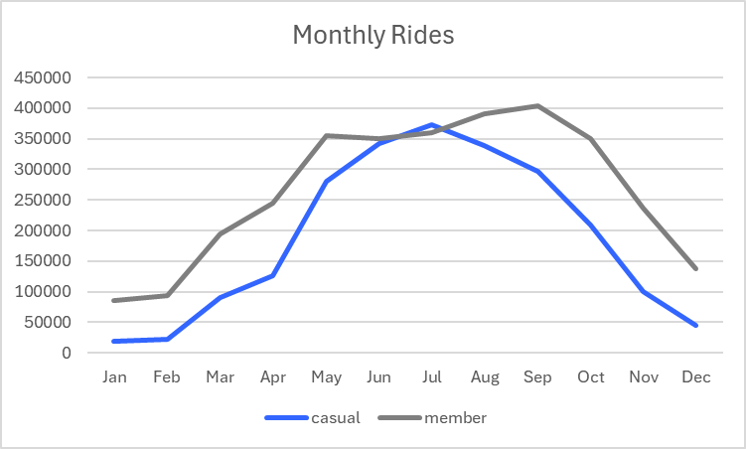
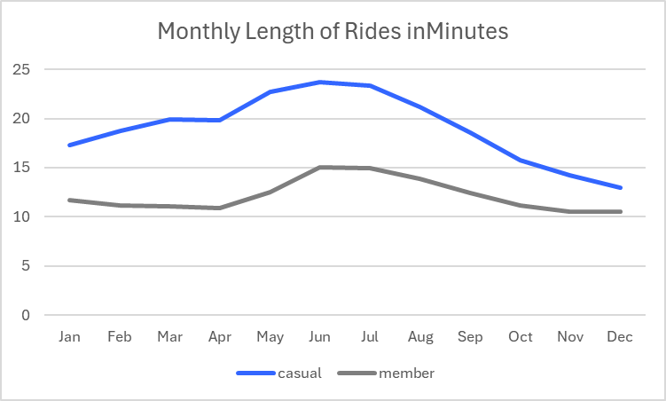
Monthly Trends

Slide 8
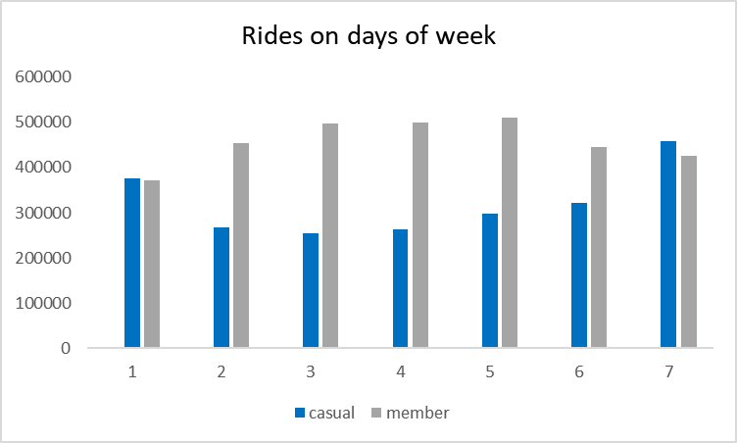
Weather condition affect Rides
The number of rides taken are highest during the warmer summer months (June, July, August) and lowest in the colder winter months (December, January, February).
Casual riders take more rides on Saturdays and Sundays.

Slide 9
Recommendations
Discounts on more rides and long rides should be offered to annual members only so that it would be an attraction to casual riders to sign up for annual membership.
This discount should run through the month of summer, specifically on weekends(Saturdays and Sundays) where the number of rides by casual riders is at its highest.
Promotions should be announced on the area around Streeter Dr & Grand Ave and DuSable Lake Shore Dr & Monroe St which are the hotspots for casual riders.

